Slide 1
Bank Marketing Analysis
DIVYA TOM

Slide 2
Objective
To build a model to predict which clients are more likely to subscribe for term deposits
To learn how to preprocess data, data cleaning
To create a logistic regression model using python on given data,to find out if the customer has subscribed to a specific plan or not

Slide 3
Problem Statement
There has been a revenue decline for the Portuguese bank and they would like to know what actions to take.
After investigation, they found out that the root cause is that their clients are not depositing as frequently as before.
The bank would like to identify existing clients that have higher chance to subscribe for a term deposit and focus marketing effort on such clients.

Slide 4
About Data
Dataset in the form of excel file.
Dataset has 41188 rows × 21columns
Dataset file is in the form of.csv
It has size of 5.1Mb

Slide 5
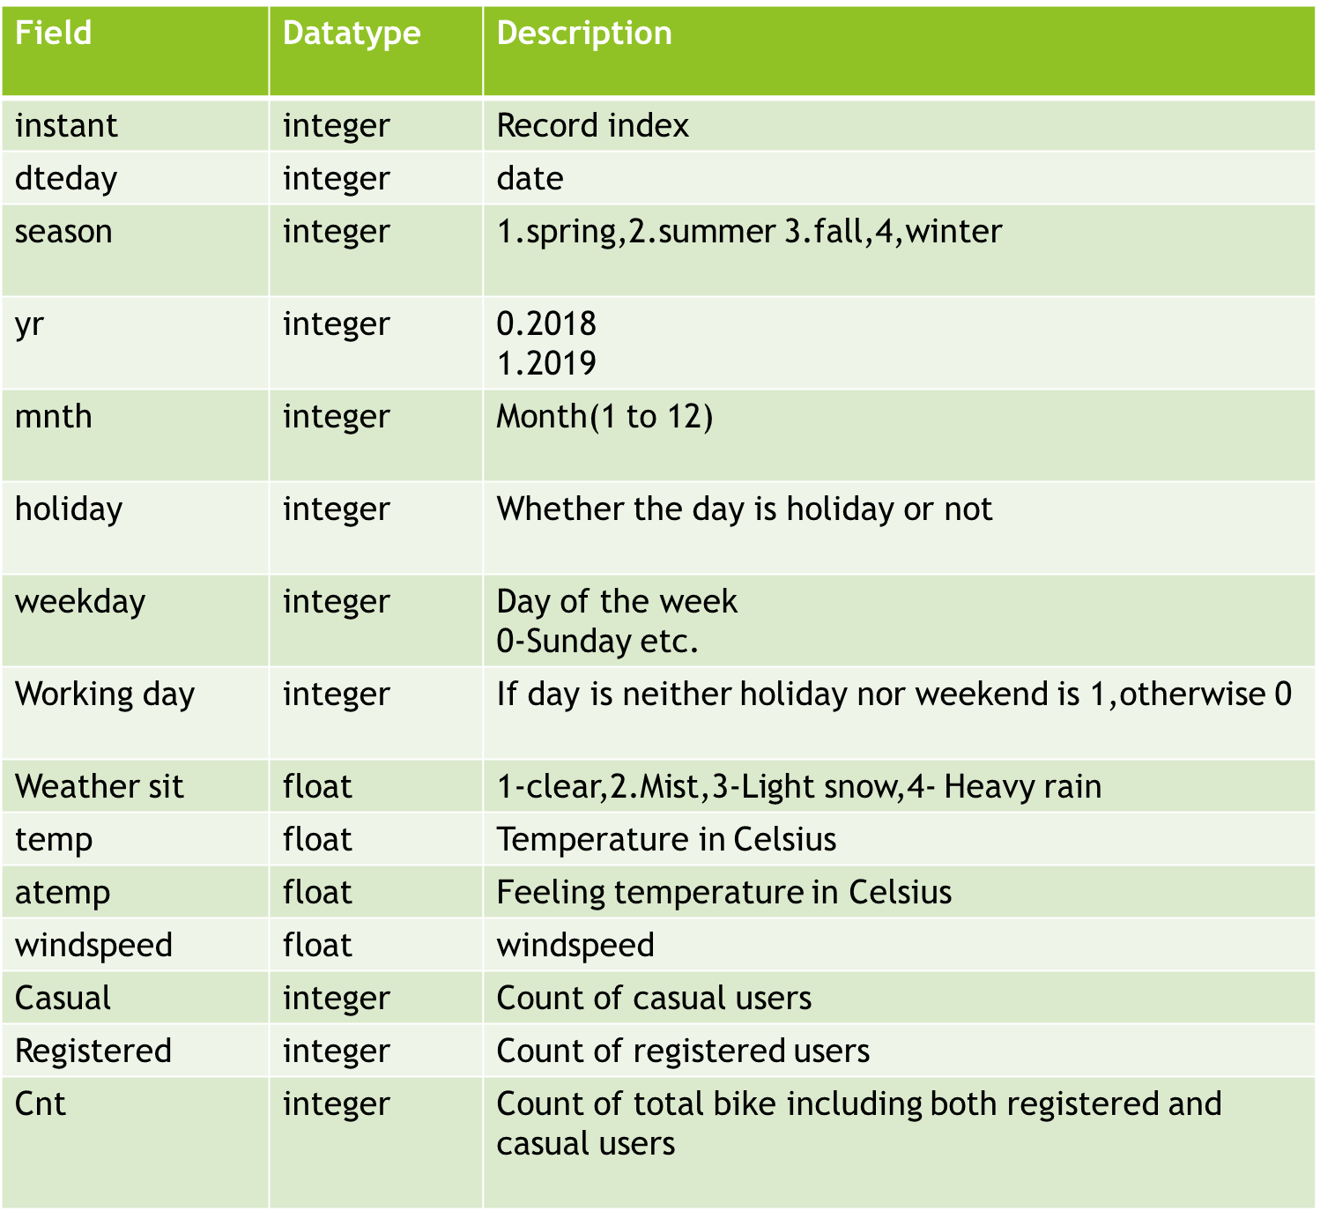
Data Description

Slide 6

Tools Used
Jupyter Notebook

Slide 7
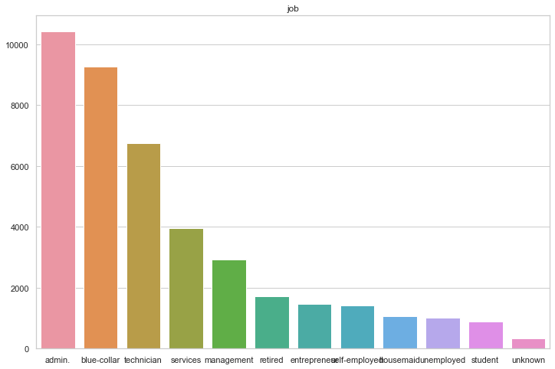
Exploratory Data Analysis
To analysis what type of clients we have more& what is the result of previous campaign
From the fig, we can conclude that people with admin jobs took part most in the campaign

Slide 8
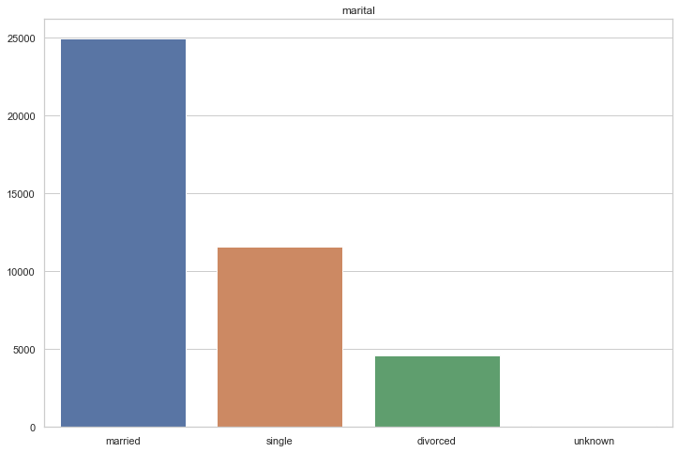
Marital Status
There are more married people ~25000 who took part in the campaign than single /divorced.

Slide 9
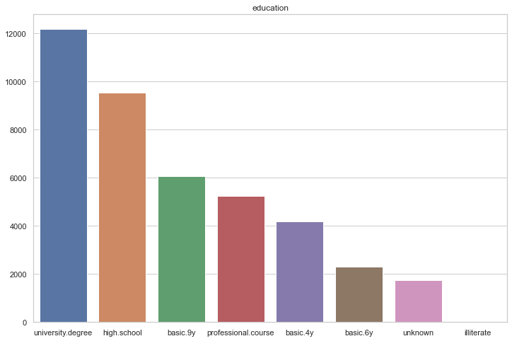
Education
There are more clients who have university degree~12000 as their education took part in campaign

Slide 10
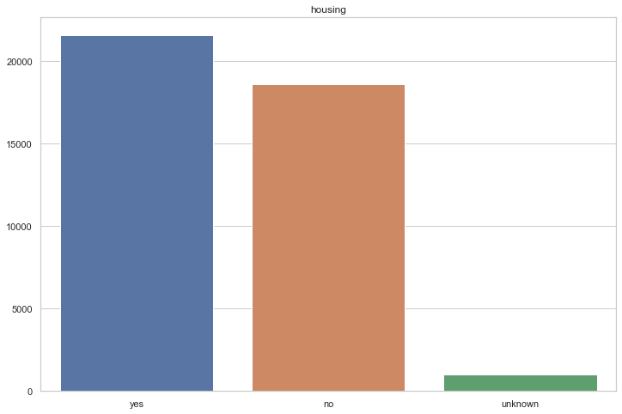
Housing
About 12% more clients has took housing loan from the bank

Slide 11
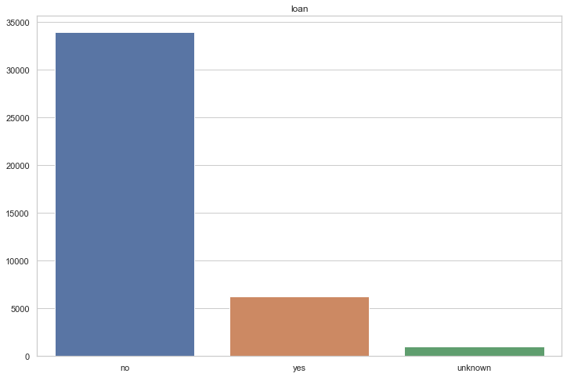
Loan
Most of the clients did not take housing loan

Slide 12
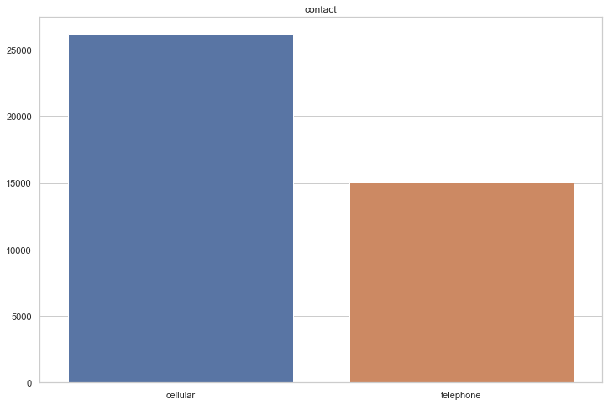
Contact
Most of the customers are contacted by cellular rather than telephone.

Slide 13
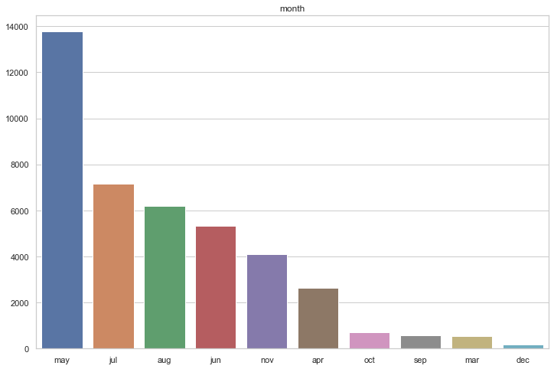
Month
May is the busiest month (Financial year starting )and least is December (May be to holiday due to festive season)
Records of some months(January, February ) are missing

Slide 14
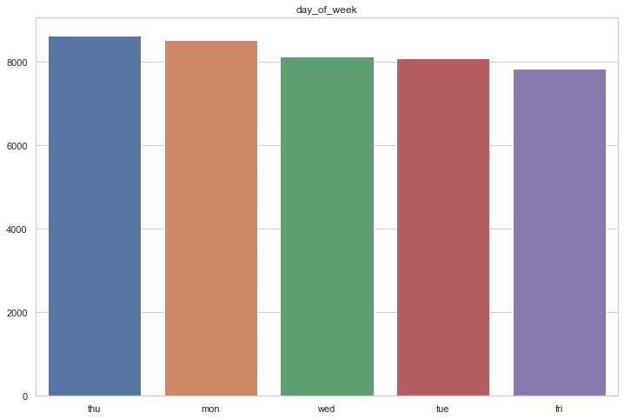
Day of week
Thursday is busiest ,followed by Monday
Almost all days (weekdays) is equally busy

Slide 15
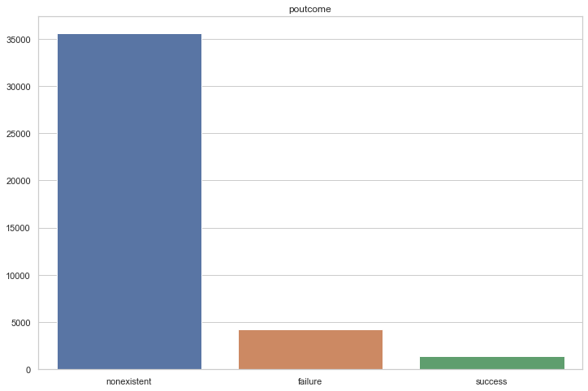
Outcome of previous Marketing campaign
Data tell us that previous marketing campaign is non existent more
Less amount of success .

Slide 16
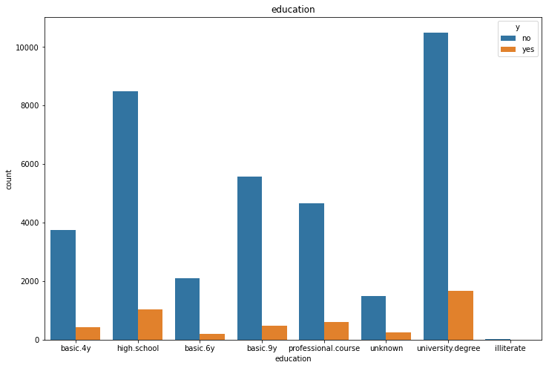
Education of user can influence to our dependent variable
From plot, university degree has most user with yes and no subscribing to the next campaign,while the illiterate is least

Slide 17
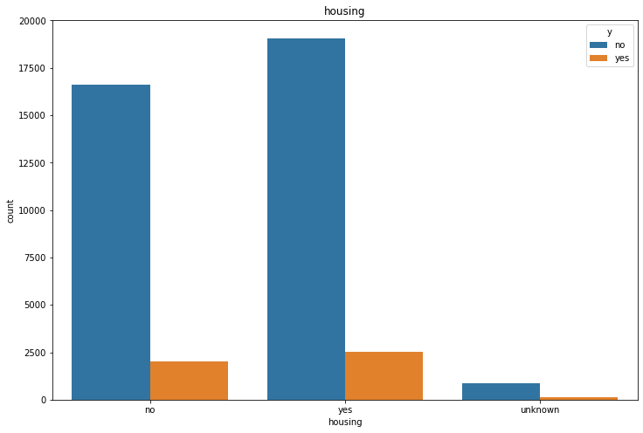
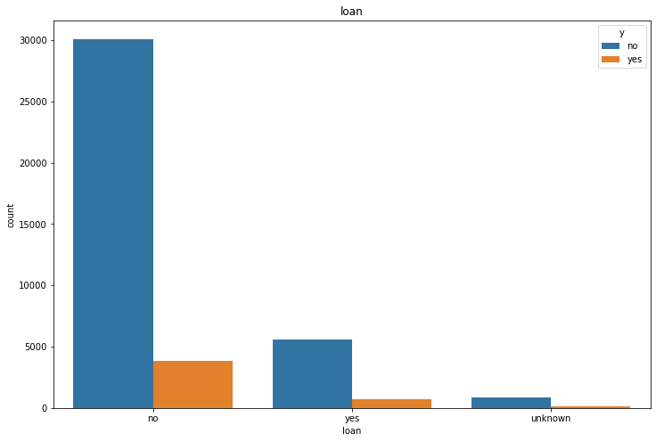
Housing loan has most user with yes and no subscribing to the next campaign
Personal loan has most users with yes and no subscribing to the next campaign.
So both these factors has effect on predicting the success of next campaign

Slide 18
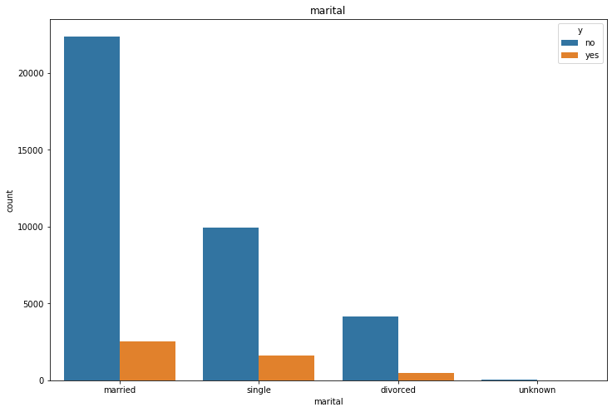
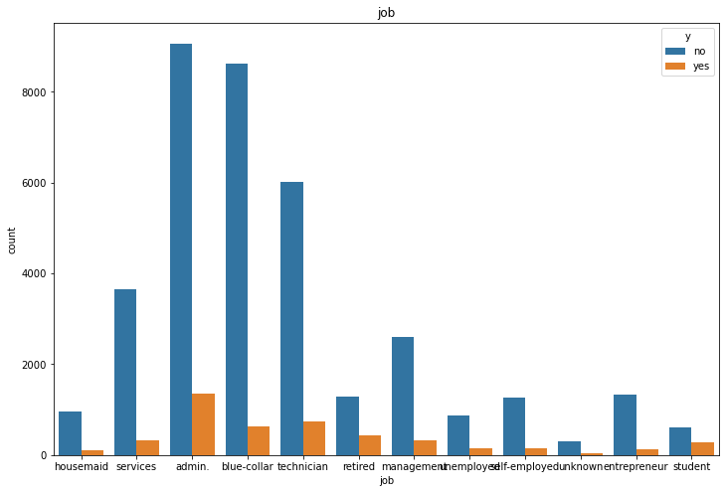
Most users are married .So it has effect on predicting yes and no subscribing to the next campaign
Admin & bluecollar job has effect on predicting yes and no subscribing to the next campaign.
So,these people should be targeted.

Slide 19
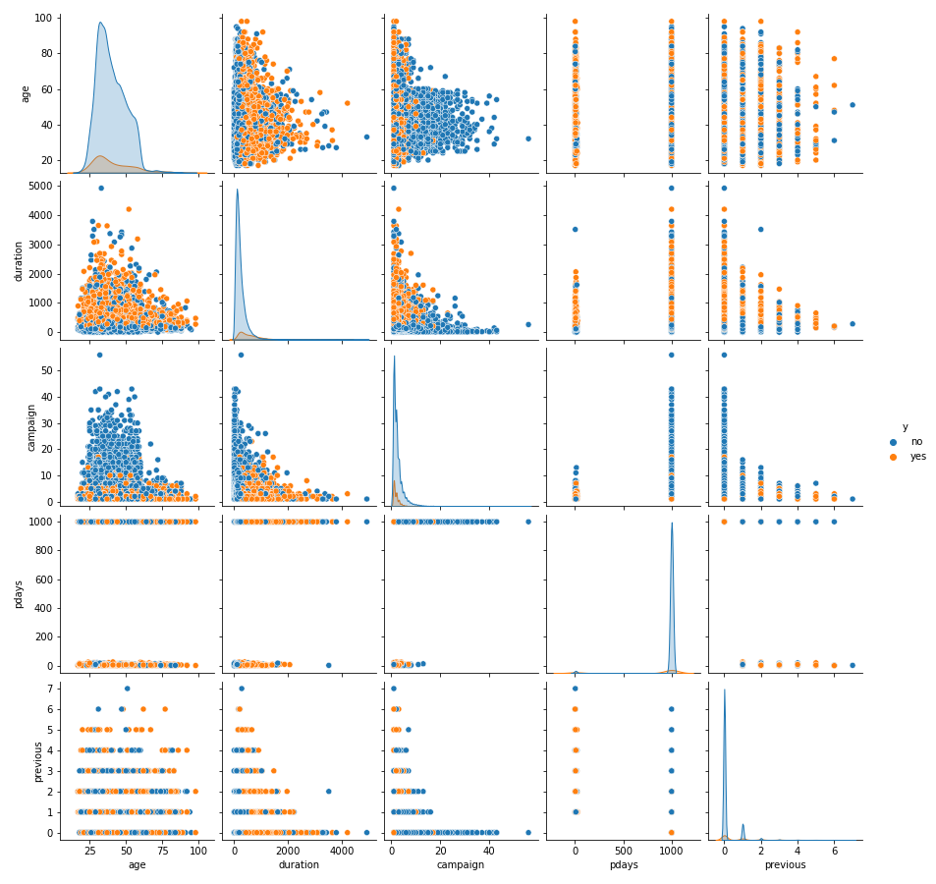
Pair plot is plotted between numerical data
From this plot duration has more effect on predicting yes/no for subscribing next campaign. It has more chance of getting yes than no.
So if duration of calls increase, chances of getting yes for subscribing next campaign increases.

Slide 20
Machine Learning model
Logistic regression method is used to train our model.
Some variables are categorical in nature, in order to convert to numerical data, get dummy method is used

Slide 21
13593
13593
Test size is 33%
Test data : 13593 observations
Train data :27595 observations

Slide 22
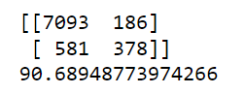
Result
Accuracy score using logistic regression is 90.689%
Confusion matrix:

Slide 23
if duration of calls increase, chances of getting yes for subscribing next campaign increases

Slide 24
Thank you!

